Slide 1
Project #4:
Warehouse Management System
Team: Can You C My Screen?
CSCI 1110-01: Intro to C Programming
Dr. Reza Sadeghi
Thursday, April 28th, 2021

Slide 2
Table of Contents
Title………………………………………………………………...
Table of Contents……………………………...………………….
Team Description…………………………...…………………….
System Description………………..……………………………..
Functions Description……….…………………………………..
Variable Descriptions….………………………………………...
Figures…….……………………………………………………….
References...……………………………………………………....
Thank You…...……………………………………………………..
1
2
3 - 4
5 - 6
7 - 13
14 - 23
24 - 27
28
29

Slide 3
Team Description
Arely J. Parra López - Allowing the user to view, request, and save items from the Warehouse Management System as well as providing the admin and guest user an exit function.
Alexander Vita - Adding, deleting, and editing items with varied details (i.e., Type, Stored Time, ID, etc) from Warehouse Management System.
Kamryn Hammond - Creating login page for admin and guest users to enter username & password for Warehouse Management System.

Slide 4
Team Description (cont.)
Jarred Crystal - Generating user-friendly software that provides a welcome page, a menu of all functions that users have access to, and tabular format of all requested information from the Warehouse Management System.
Sophie Ross - Allowing admin to view the list of borrowing requests as well as accept/reject borrowing requests made by guest users in the Warehouse Management System.

Slide 5
System Description
Greeted by a WMS Welcome Page with registration or login.
If logging in as an Admin, individual is able to:
View a list of usernames & passwords
Search for usernames & passwords in the system
Change usernames/passwords for admin & guest
Add/Remove admin & guest
Add/Remove/Edit items from the WMS
View/Search for items from the WMS
View list of borrowing requests from guest users
Accept/Deny borrowing requests from guest users

Slide 6
System Description (cont.)
If logging in as Guest User, individual is able to:
Search for items in the WMS
Make a list of favorite items from the WMS
Request items to borrow/buy
View item’s borrowing history
All users can exit from the WMS when in the Login Menu, Admin Menu, or the Guest Menu.

Slide 7
Functions Description
Crystal:
int loginMenu(void)
Allows for new registration of users and the selection of either the admin or guest login prompt
void main(void)
Provides the main interface to the login menu dictating which function will be executed following user input
int adminMenu(void)
Provides the menu options within the admin menu
void admin(void)
Provides the main interface to the admin menu dictating which function will be executed following user input

Slide 8
Functions Description (cont.)
Crystal:
int guestMenu(void)
Provides the menu options within the guest menu
void guestMain(void)
Provides the main interface to the guest menu dictating which function will be executed following user input

Slide 9
Functions Description (cont.)
Hammond:
int* adminLogin(void)
Allows admin to search for their login from the WMS inventory.
int* guestLogin(void)
Allows guest users to search for their login from the WMS inventory using their private encryption key.
void view(void)
Provides an organized view of all the Admin & Guest User’s encryption keys, usernames, and passwords.
int* search(void)
Allows the Admin to search the WMS LogIn.txt file for a specific encryption key, username, and password.

Slide 10
Functions Description (cont.)
Hammond:
void edit(void)
Allows the Admin to select a specific user from the WMS and edit their login information.
void add(void)
Allows the Admin to add a new user to the WMS with an encryption key, username, and password.
void delete(void)
Allows the Admin to select and delete a user from the WMS.

Slide 11
Functions Description (cont.)
Vita:
void addItems (void)
Admin can add an item to the inventory
int* searchItems(void)
Admin can search for an item within the inventory
void editItems (void)
Admin can edit an items characteristics
void deleteItems(void)
Admin can delete an item from the inventory
void viewItems(void)
Admin can view all items within the inventory

Slide 12
Functions Description (cont.)
Ross:
Void acceptDeny(void)
Allows Admin to accept or deny borrowing request list from guest users.
Void viewBorrowing(void)
Allows Admin to view all borrowing requests from guest users.

Slide 13
Functions Description (cont.)
Parra López:
void registration(void)
New individuals can create a new accounts within the WMS.
int* searchWMS(void)
Guest can search for an item from the WMS inventory.
void makeList(void)
Guest can make a list of favorite items from the WMS inventory.
void viewList(void)
Guest can view their list of favorite items.
void requestItems(void)
Guest can request to borrow/buy an item.
void viewHistory(void)
Guest can view the borrowing/purchase history of items.

Slide 14
Variables Description
Crystal:
int adminMenu(void)
int input;
void admin(void)
int option;
char quit;
int loginMenu(void)
int input;
int guestMenu(void)
int input;
void guestMain(void)
int task;
char quit;
void main(void)
int choice
char quit;
Notes:
Int input - Stores integer for user menu selection 1-13
Int option - stores integer from adminMenu() for switch case
Char quit - stores caracter for Y or N to quit
Int input - Stores integer for user menu selection 1-6
Int task - stores integer from guestMenu() for switch case
Int input - Stores integer for user menu selection 1-4
Int choice - stores integer from loginMenu() for switch case

Slide 15
Variables Description (cont.)
Hammond:
int* adminLogin(void)
int* guestLogin(void)
int* search(void)
static int output[2]
char key[100]
char input[100]
FILE *myfile
char myString[100]
int line=0
int find=0
int fieldNumber=0
char quit
void view(void)
struct entity
char encrypt[20]
char username[20]
char password[20]
struct entity new
char myString[100]
int pline=0

Slide 16
Variables Description (cont.)
Hammond:
void edit(void)
int* place=search()
int line=place[1]
int find=place[0]
char username[20], password[20]
FILE *invfile
FILE *temp
char myString[100]
int pline=0
char quit
void add(void)
struct entity
char encrypt[20]
char username[20]
char password[20]
struct entity new
FILE *myfile
char quit

Slide 17
Variables Description (cont.)
Hammond:
void delete(void)
int* place=search()
int line=place[0]
int find=place[0]
FILE *originalfile
FILE *tempfile
char myString[100]
int pline=0
char quit

Slide 18
Variables Description (cont.)
Vita:
void addItems (void)
struct entity
char Type...[100]
struct entity new
FILE *invfile
char quit
int* searchItems(void)
static int output[2]
char key[100]
char input[100]
FILE *invfile
char myString[100]
int line=0
int find=0
int fieldNumber=0
int pline=0
Notes:
int* searchItems(); - initiates search items function
struct entity - creates a new data type with multiple variables
char Type...[100]- stores various information from user
struct entity new - creates a new data type with the new. variable
static int output[2] - maintains variables value in memory even after function ends
char key[100] - user input for search function
char input[100]; - input becomes the key
FILE *invfile; - intitaties file
char myString[100] - stores inventory search
int line = 0 - integer for line in search
int find = 0 - integer for search location
int fieldNumber = 0 - variable for reading all characteristics of an item
FILE *myfile; - intitaties file
char quit; - stores variable to quit function

Slide 19
Variables Description (cont.)
Vita:
void editItems (void)
int* place=searchItems()
int find = 0
int line = 0
char Type….[100]
FILE *invfile
FILE *tempfile
char myString[100]
int pline=0
char quit
void deleteItems(void)
int* place=searchItems()
int find=place[0]
int line=place[1]
FILE *invfile
FILE *tempfile
char myString[100]
int pline=0
char quit
Notes:
Static int output [2] - maintains variables value in
Char key [100] - user input for search function
Char input[100] - input becomes the key
FILE *invfile - Initiates File
Char myString[100] - stores inventory search
int line = 0 - integer for line in search
int find = 0 - integer for search location
int fieldNumber = 0 - variable for reading all
int pline = 0 ; - variable for location of pointer
int* place=searchItems(); - initiates search function
int find = place[0];
int line = place [1];
char Type….[100]; - stores various information from user
FILE *invfile- Initiates File
char myString[100]-stores inventory search
char quit;-stores variable to quit function

Slide 20
Variables Description (cont.)
Vita:
viewItems(void)
FILE *invfile
struct entity
char Type….[100;
struct entity new
char Type….[100];
char myString[100000]
int pline=0
Notes:
int* place=searchItems() - initiates search function
int find = place[0];
int line = place [1];
FILE *invfile- Initiates File
FILE *tempfile- Initiates Temp File
char myString - stores inventory search
int pline = 0 - integer for line in search
int find = 0 - integer for search location
char quit-stores variable to quit function
FILE *invfile;- Initiates File
struct entity-creates a new data type with multiple variables
char Type….[100];
struct entity new
char Type….[100];-stores various information from user
char myString[100000]-stores inventory
int pline=- variable for location of pointer

Slide 21
Variables Description (cont.)
Ross
void viewBorrowing(void)
FILE myfile*
struct entity
char Type...[100]
struct entity new
char myString[10000]
int pline = 0
void acceptDeny(void)
struct entity
char ID[20]
char accept[20]
char deny[20]
FILE myfile*
char quit
Notes:
void viewBorrowing(void)
FILE myfile* : defines the text file name from memory
struct entity: data type that stores various information (type, price, location, etc)
char Type[100]: declares an array that stores that data type up to 100 characters
struct entity new: data type that stores new information (type, price, location, etc)
int pline = 0: integer data type that initializes the borrowing request list history to zero when printing information in the Request.txt file
void acceptDeny(void)
struct entity: data type that stores new information (ID/accept/deny)
FILE myfile*: defines the text file name from memory
char ID[20]: declares an array with a character type that stores the ID of the product up to 20 characters
fclose(myfile): closes file

Slide 22
Variables Description (cont.)
Parra López:
void registration(void)
struct entity
char encrypt[20]
char username[20]
char password[20]
struct entity new
FILE *myfile
char quit
int* searchWMS(void)
static int output[2]
char ID[100]
char input[100]
FILE *myfile
char myString[100]
int line=0
int find=0
int fieldNumber=0
char quit
Notes:
struct entity & struct entity new - user-defined data type that stores related information.
FILE *myfile - defines the name of the text file with a pointer to the address of the text file from the memory.
char quit - character data type that stores information.
static int output[10] - static integer data type that will preserve the value of the output in the memory while the program is running after searching for the Item’s ID within an array declaration with up to 10 item associated details.
char myString[100] - array declaration with a character data type that stores the item’s ID number with associated details up to 100 characters.
int line=0 & int find=0 & int fieldNumber=0 - integer data types that initialize the WMS inventory line, the find capability, and field number to zero when looking within a text file.
int pline=0 - integer data type initializes the WMS inventory printing line to zero when printing the item information found within a text file.

Slide 23
Variables Description (cont.)
Parra López:
void viewList(void)
void viewHistory(void)
FILE *myfile
struct entity
char Type...[100]
struct entity new
char myString[10000]
int pline=0
void makeList(void)
void requestList(void)
struct entity
char Type...[100]
char Length[100]
struct entity new
FILE *myfile
char quit
Notes:
struct entity & struct entity new - user-defined data type that stores related information.
FILE *myfile - defines the name of the text file with a pointer to the address of the text file from the memory.
char quit - character data type that stores information.
static int output[10] - static integer data type that will preserve the value of the output in the memory while the program is running after searching for the Item’s ID within an array declaration with up to 10 item associated details.
char myString[100] - array declaration with a character data type that stores the item’s ID number with associated details up to 100 characters.
int line=0 & int find=0 & int fieldNumber=0 - integer data types that initialize the WMS inventory line, the find capability, and field number to zero when looking within a text file.
int pline=0 - integer data type initializes the WMS inventory printing line to zero when printing the item information found within a text file.

Slide 24
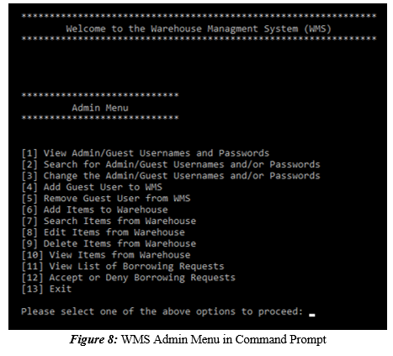
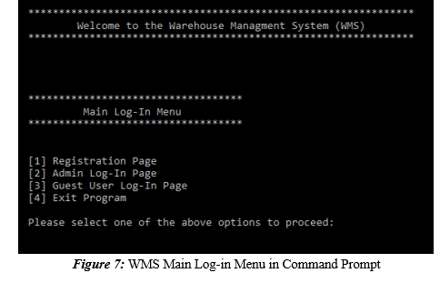
Figures

Slide 25
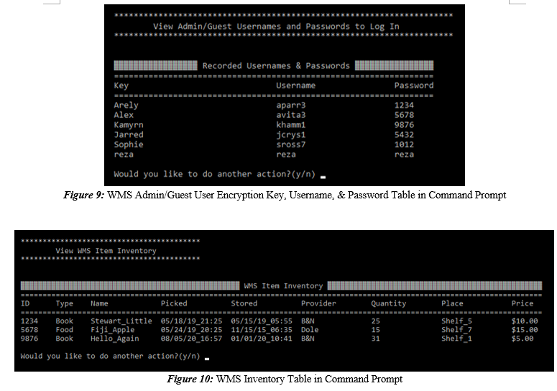
Figures (cont.)

Slide 26
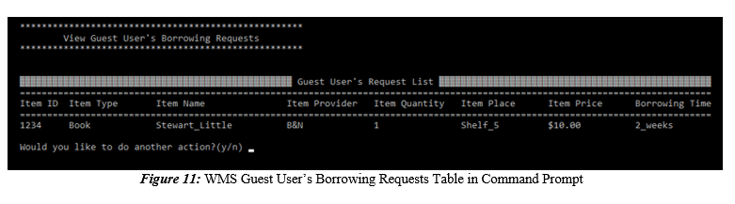
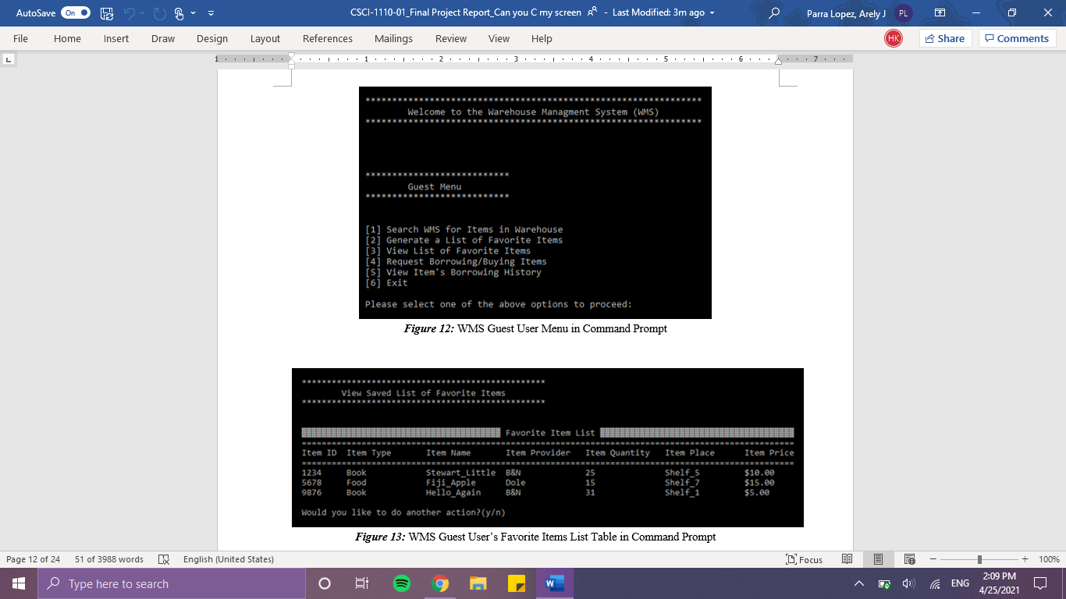
Figures (cont.)

Slide 27
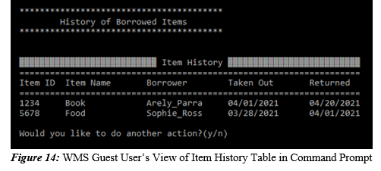
Figures (cont.)

Slide 28
References
Fischer, A. E., Fischer, M. J., & Eggert, D. W. (2016, August 30). Applied Introductory C Programming - University of New Haven. Chapters from 2nd edition. http://eliza.newhaven.edu/apc/.
Sadeghi, R. (2020, December 14). RezaSadeghiWSU/LMS. GitHub. https://github.com/RezaSadeghiWSU/LMS.
Sadeghi, R. (2020, December 15). RezaSadeghiWSU/Calendar-Management-System. GitHub. https://github.com/RezaSadeghiWSU/Calendar-Management-System.
Sadeghi, R. (2021). passwordSystem.c. West Haven; Reza Sadeghi.

Slide 29
Thank You

